Slide 1

Writing a Stormwater PSA
Encouraging Stewardship to Protect Our Water

Slide 2
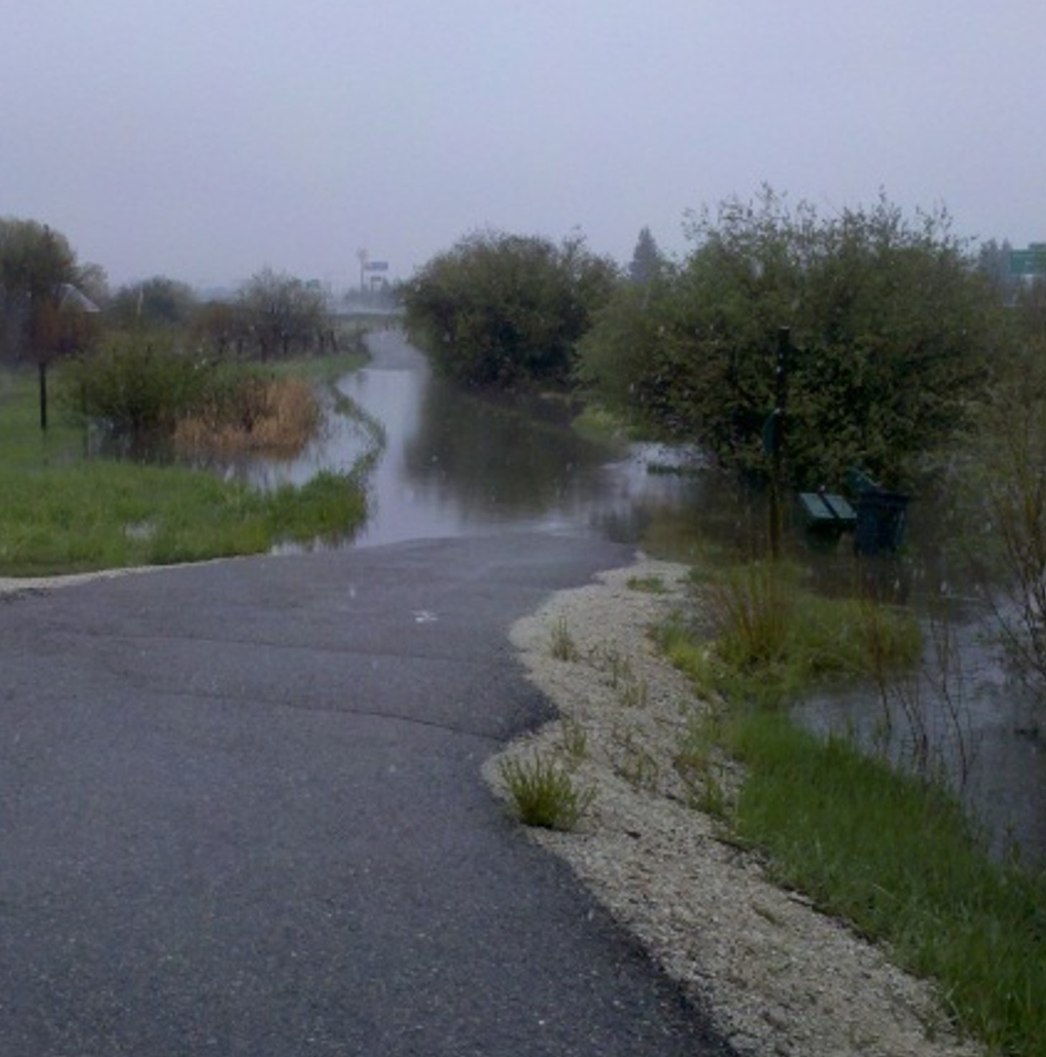
What is Stormwater?
Water that runs off an area of land following a storm event.
Where does stormwater go? Is it treated like the water in our houses or schools?
Blacktail Creek, 2011 Flooding
Notes:
Snowmelt is included in stormwater

Slide 3
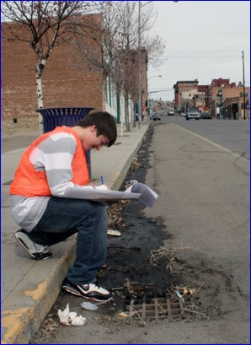
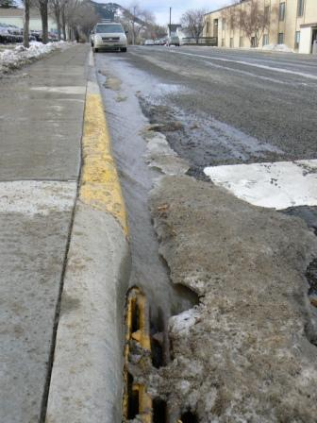
Why Do Cities Monitor Stormwater?
  Stormwater picks up pollution and other materials
  Stormwater is the #1 source of pollutants for creeks, rivers, lakes, and oceans!

Slide 4
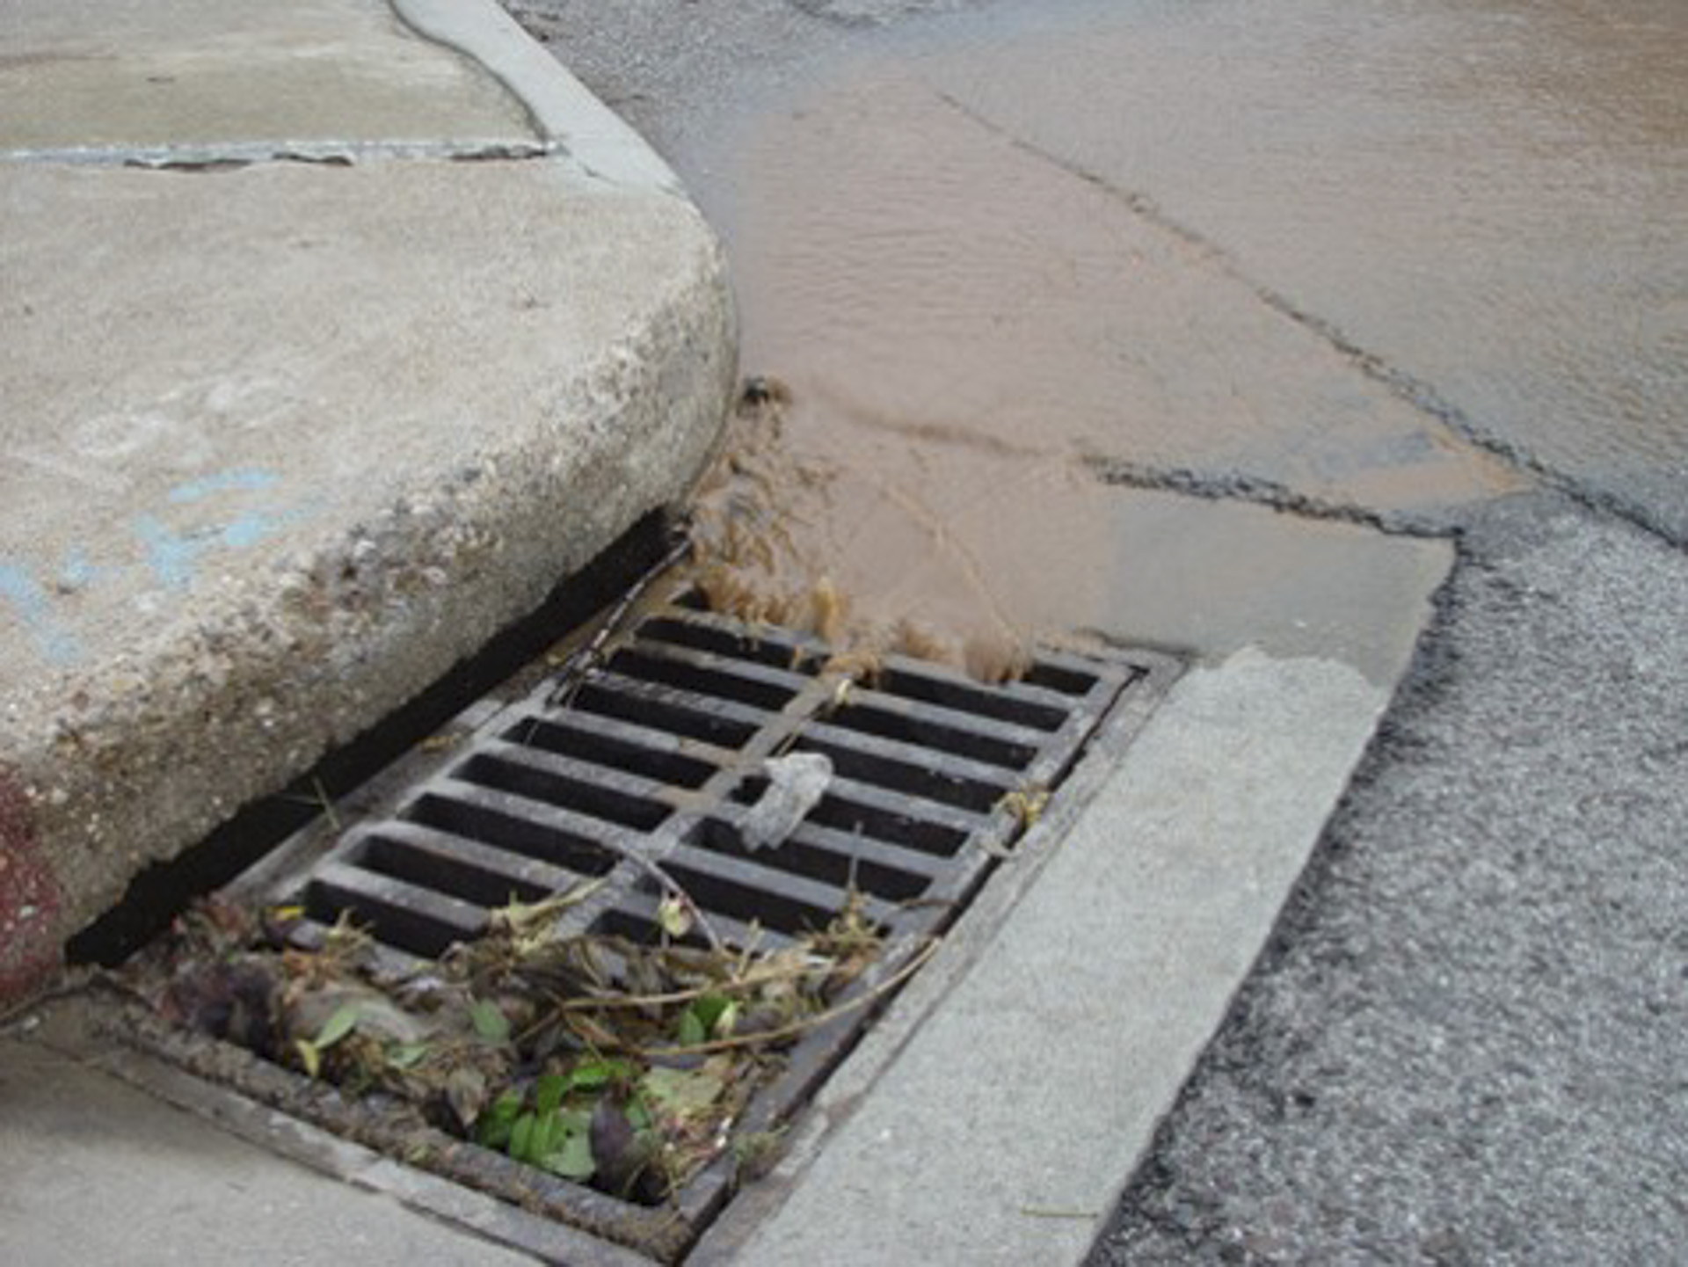
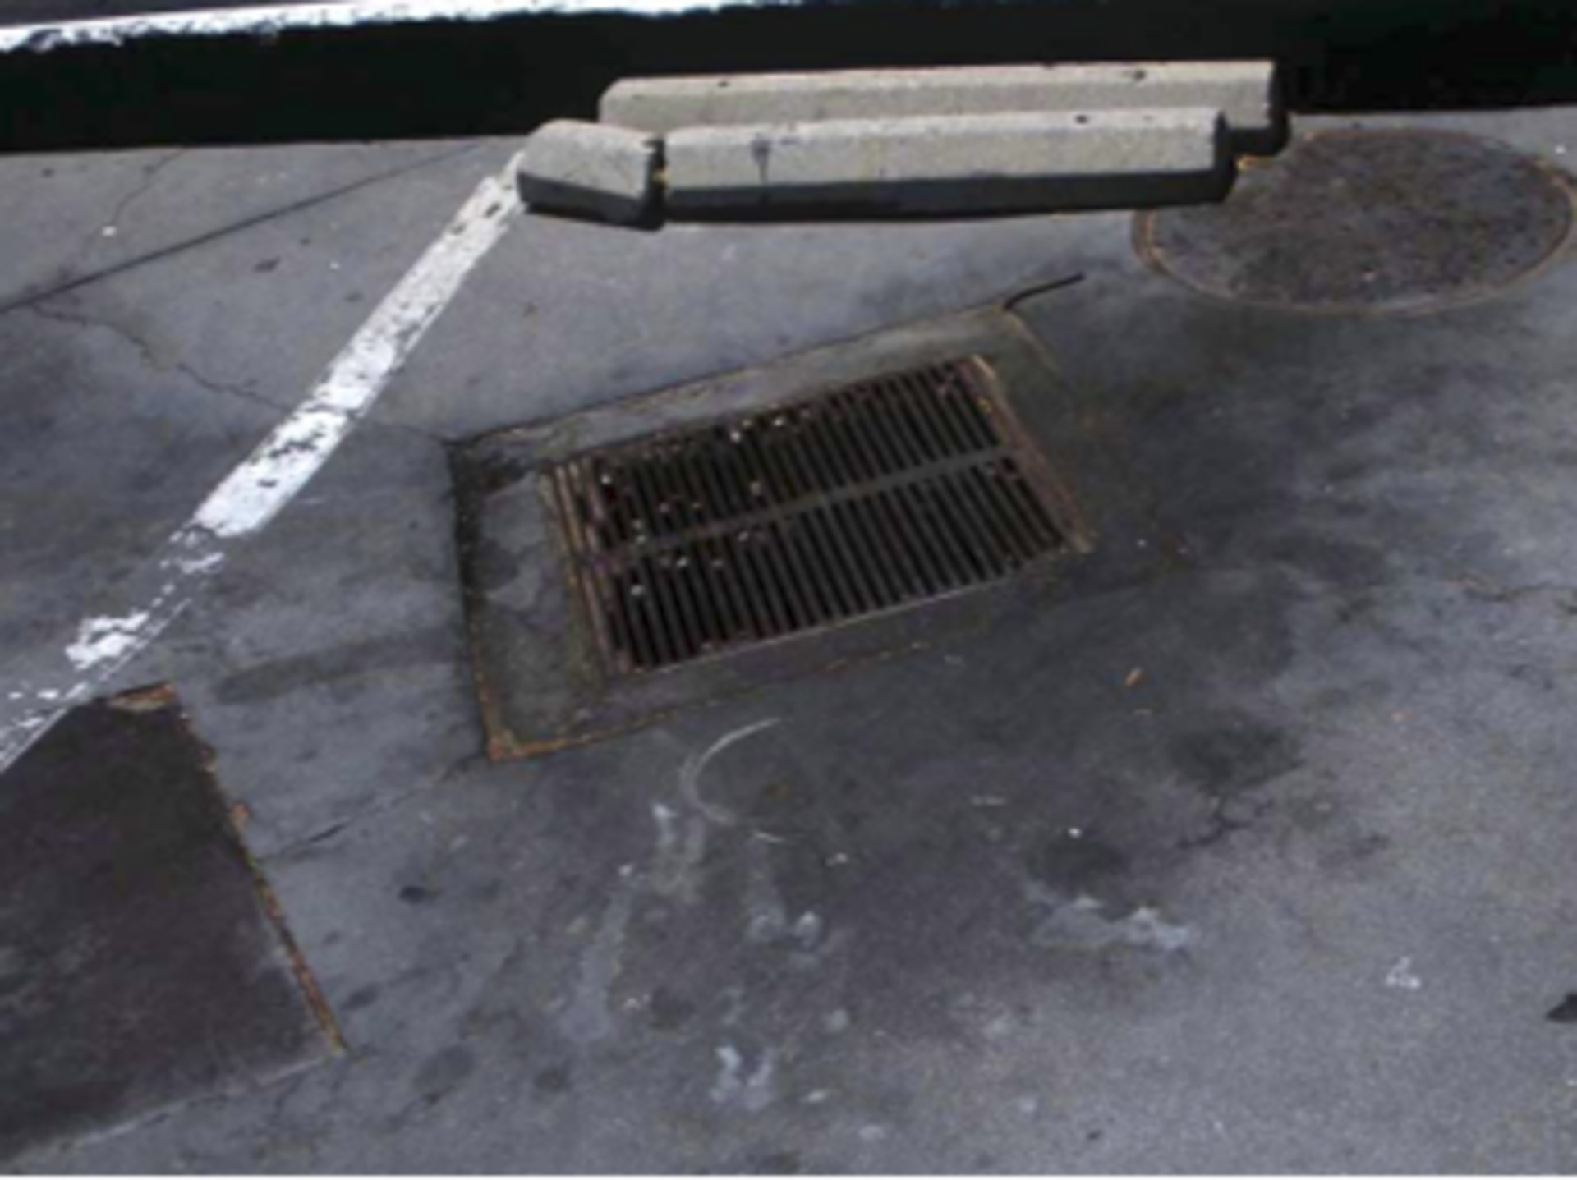
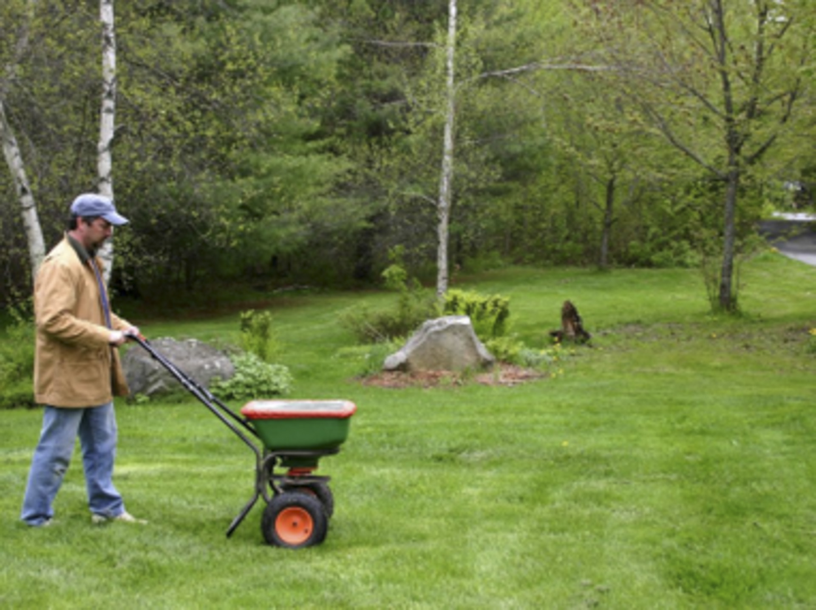
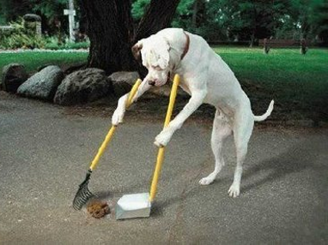
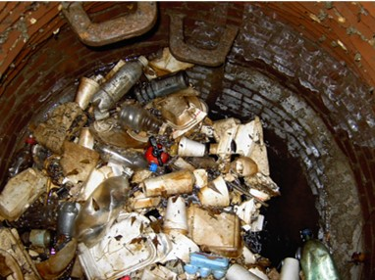
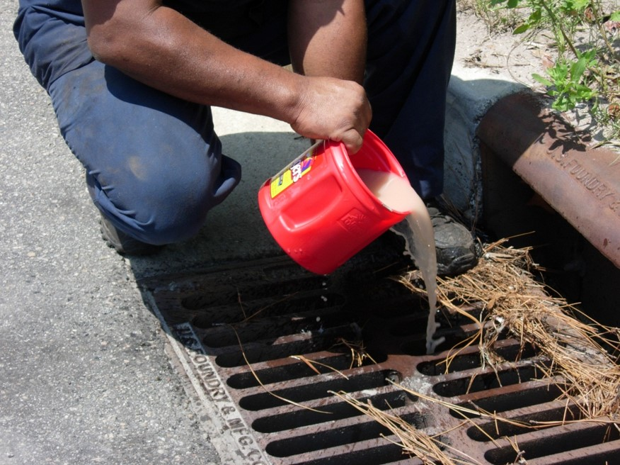
What’s in Butte’s Stormwater?
Notes:
Fertilizer is plant food, which will increase plants in creek
Bad for aquatic life

Slide 5
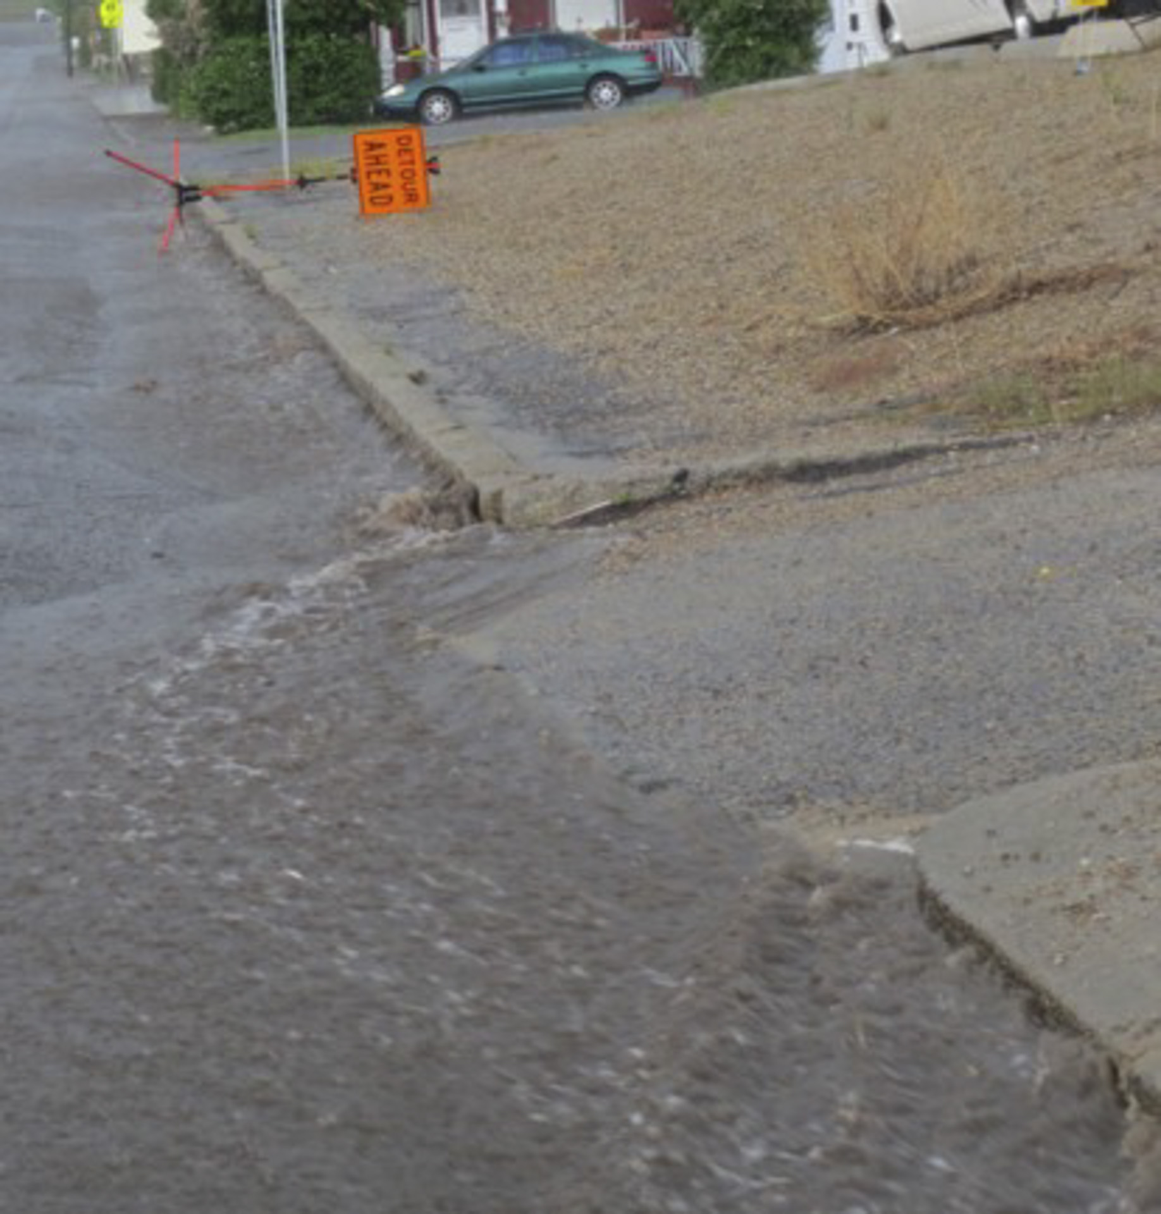
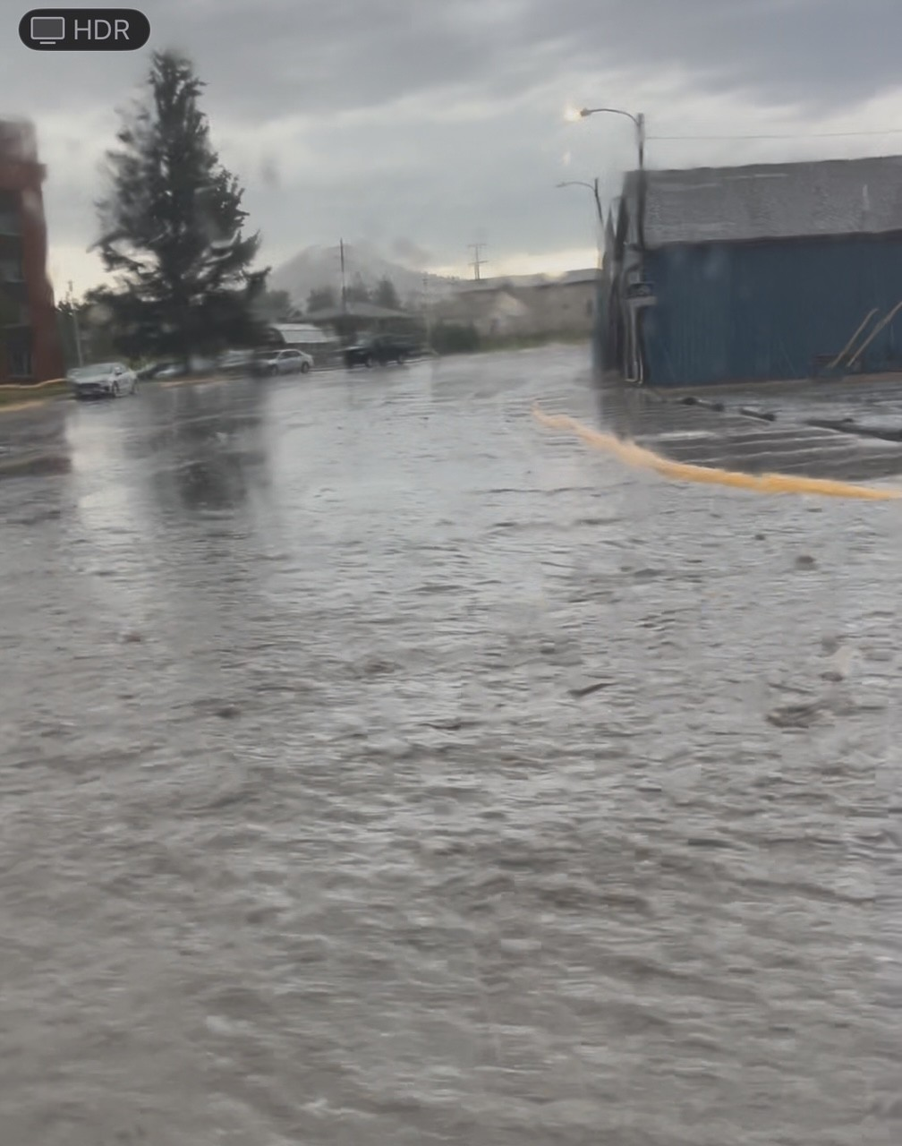
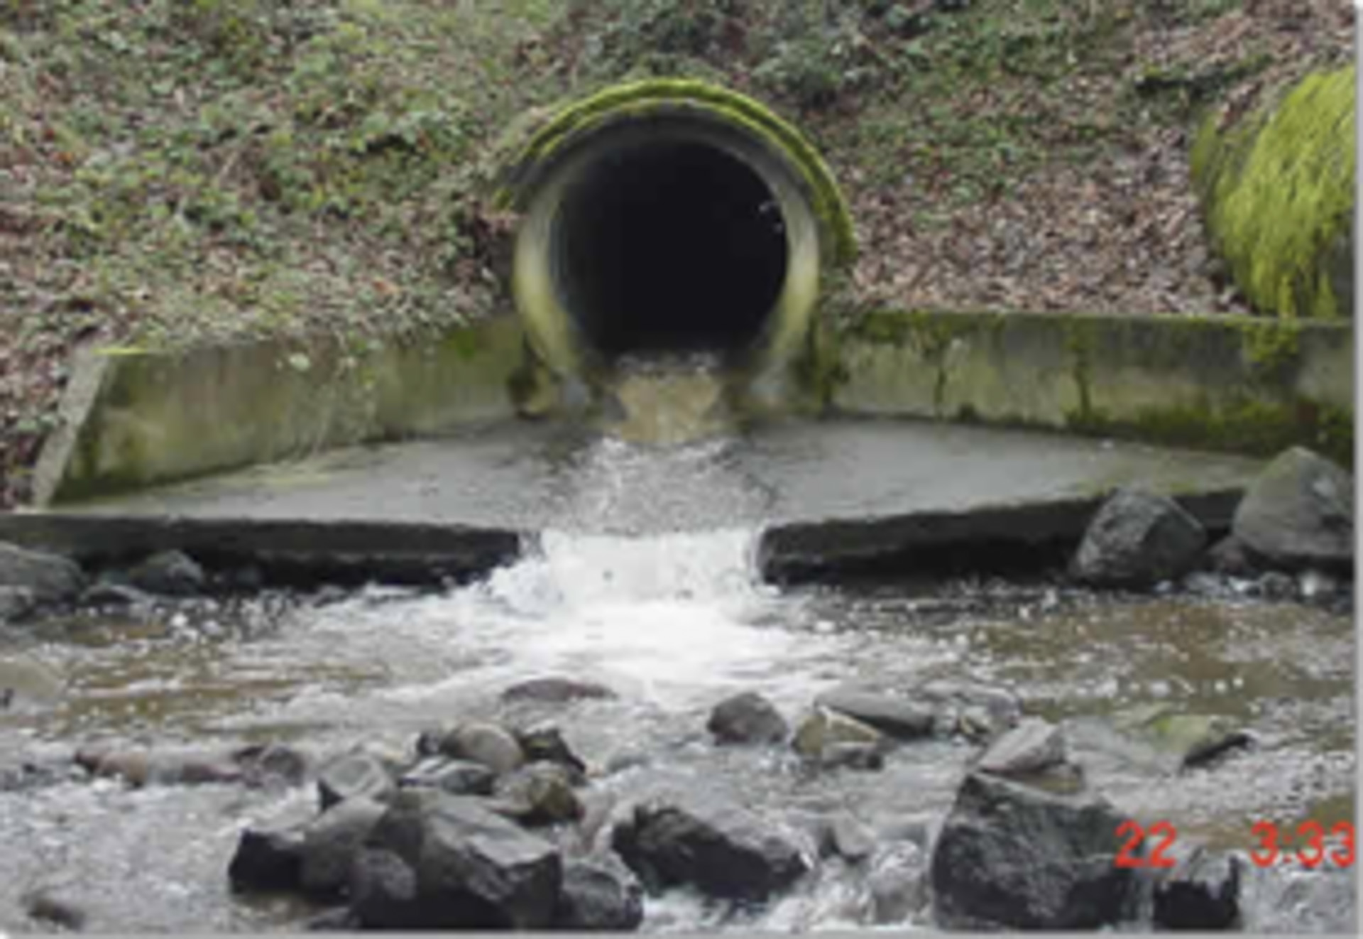
Why Are Stormwater Pollutants A Problem For Streams?
Stormwater
DOES NOT GET TREATED
before entering creeks or rivers

Slide 6
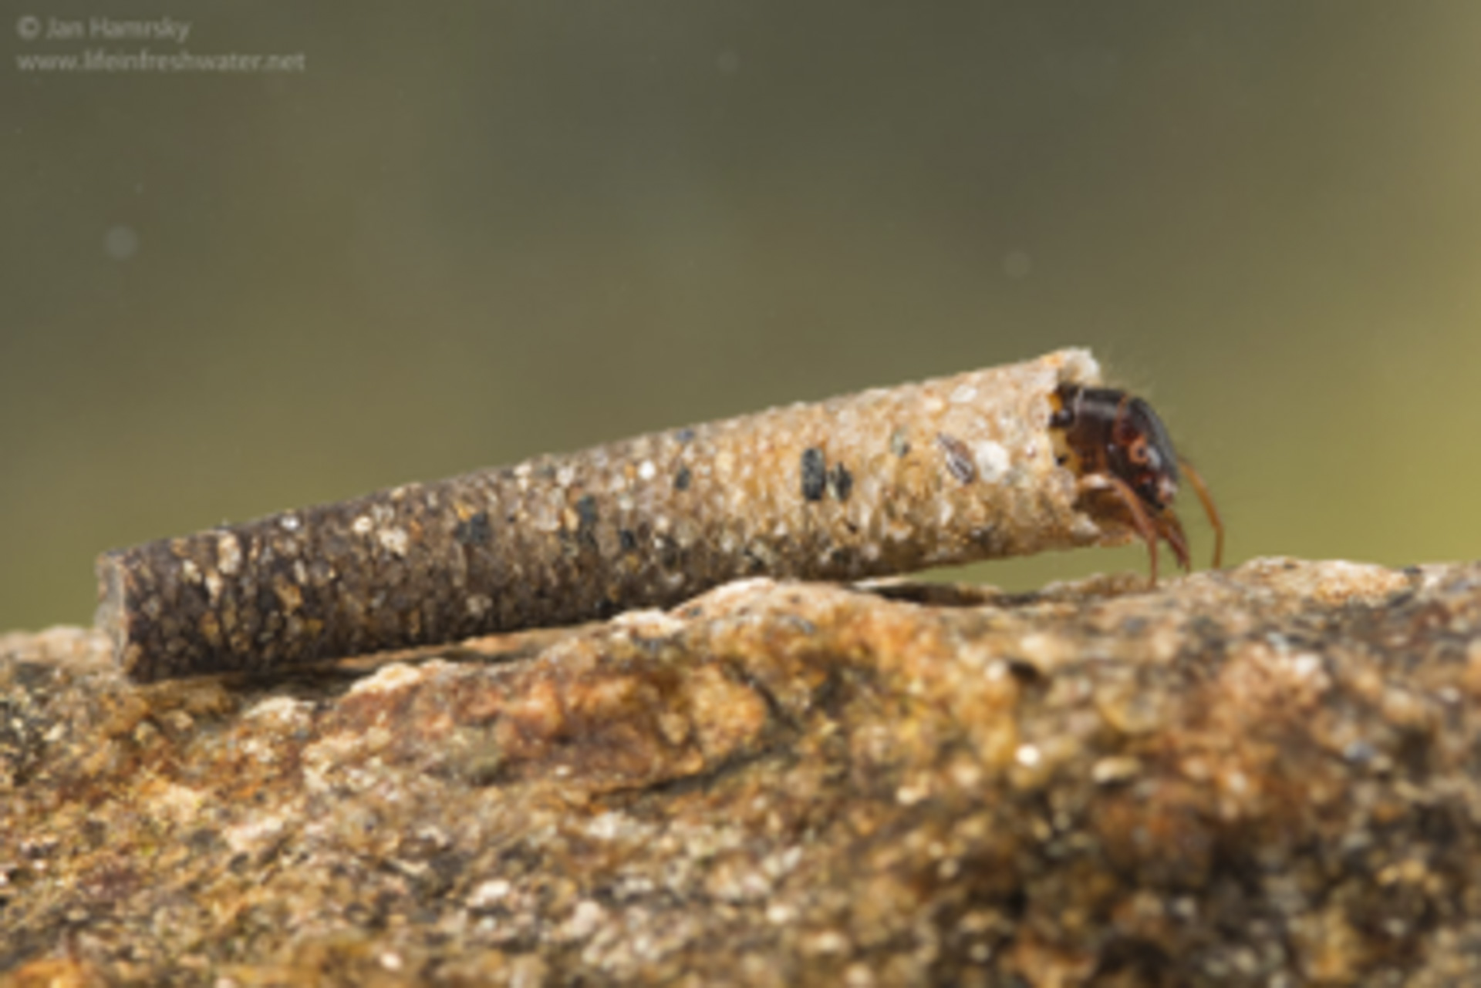
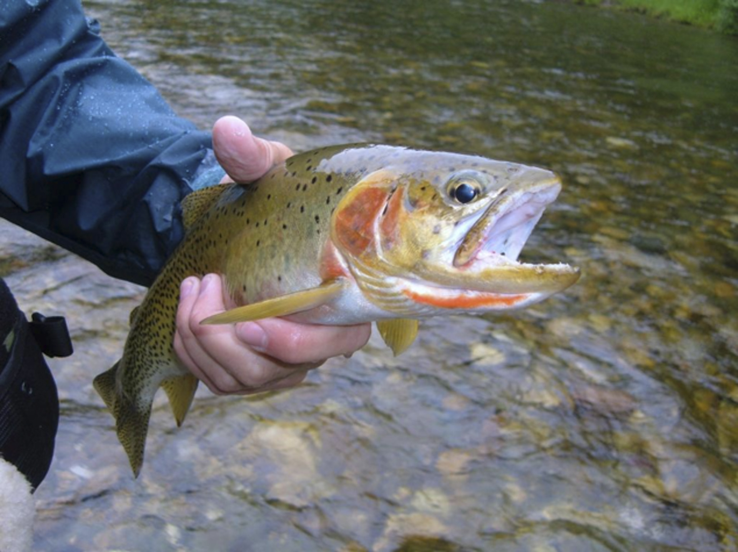
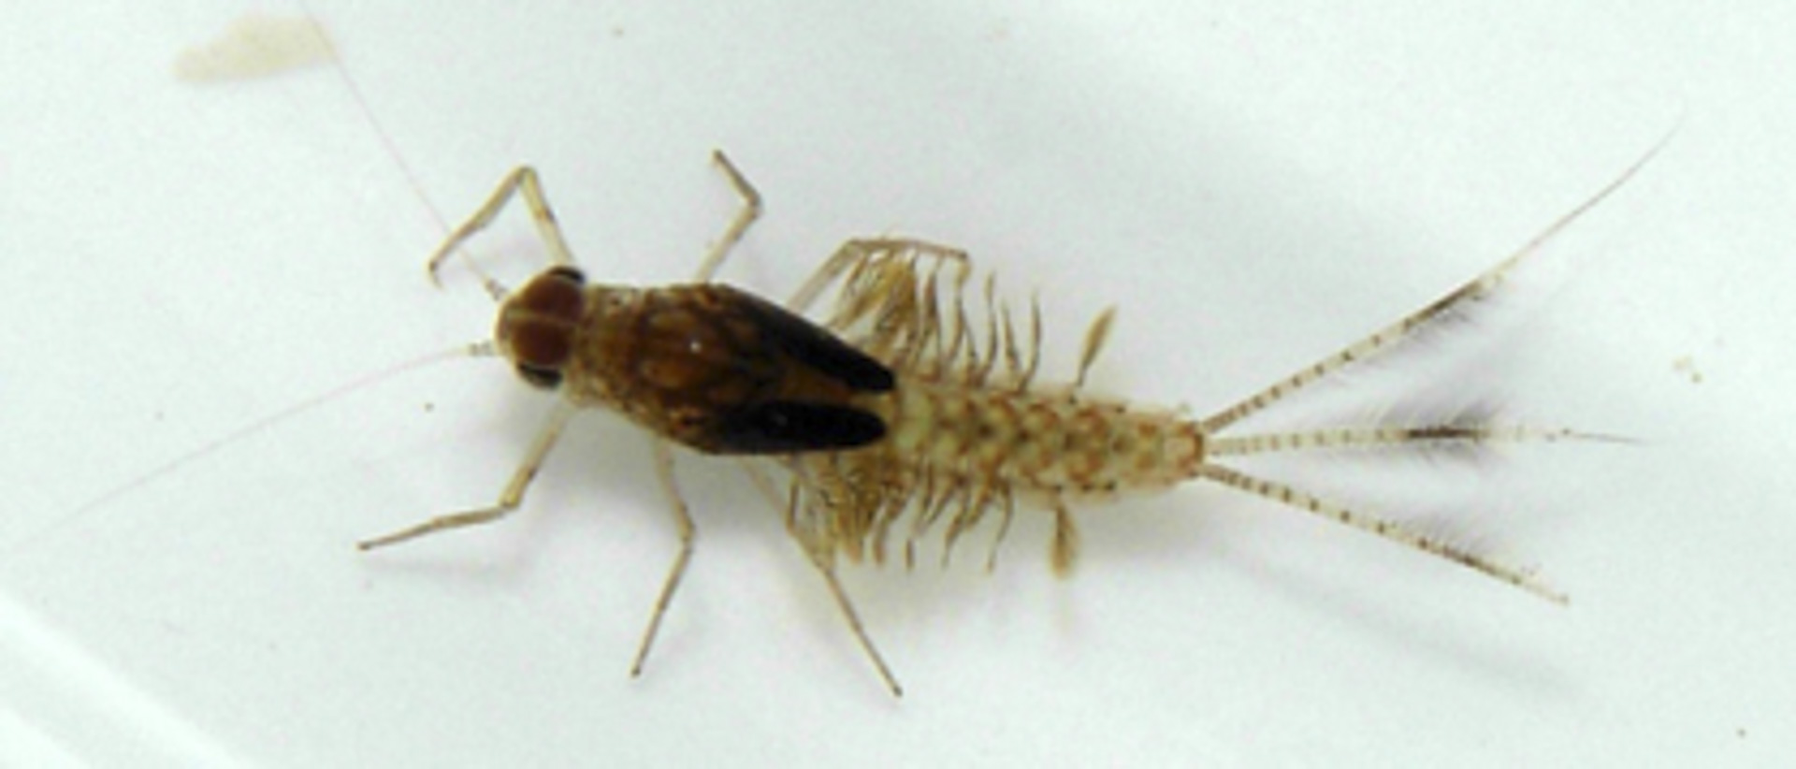
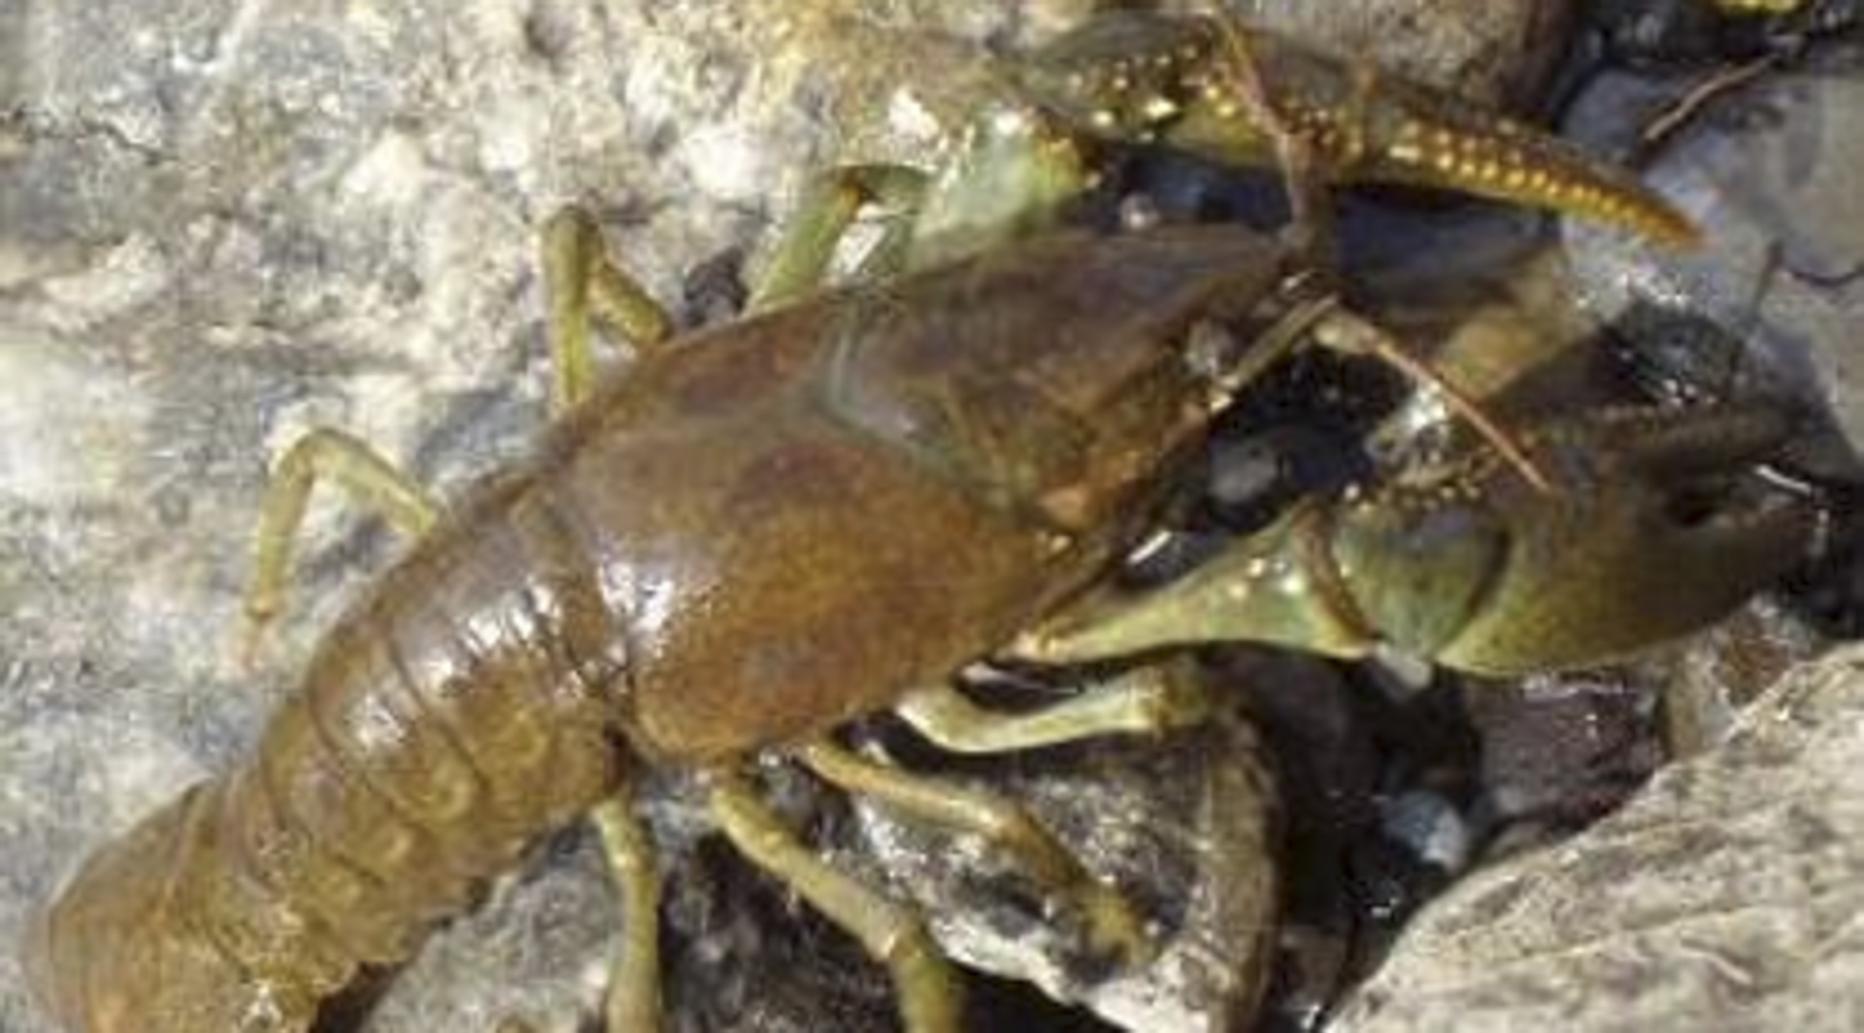
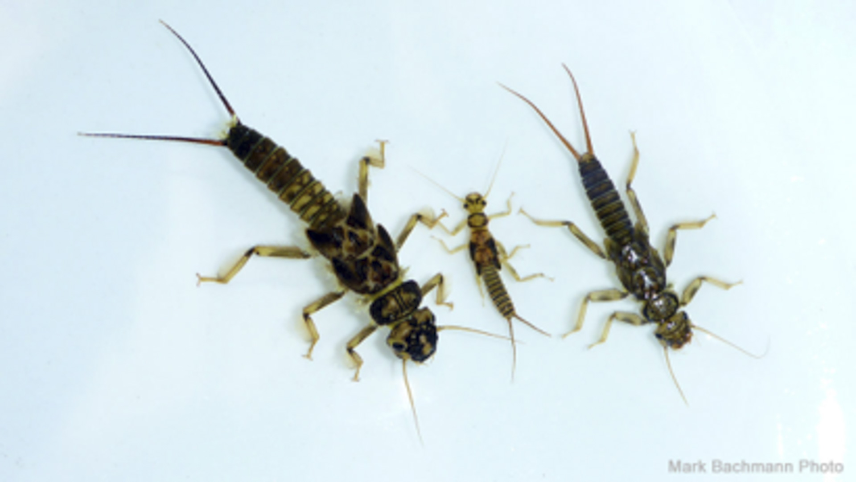
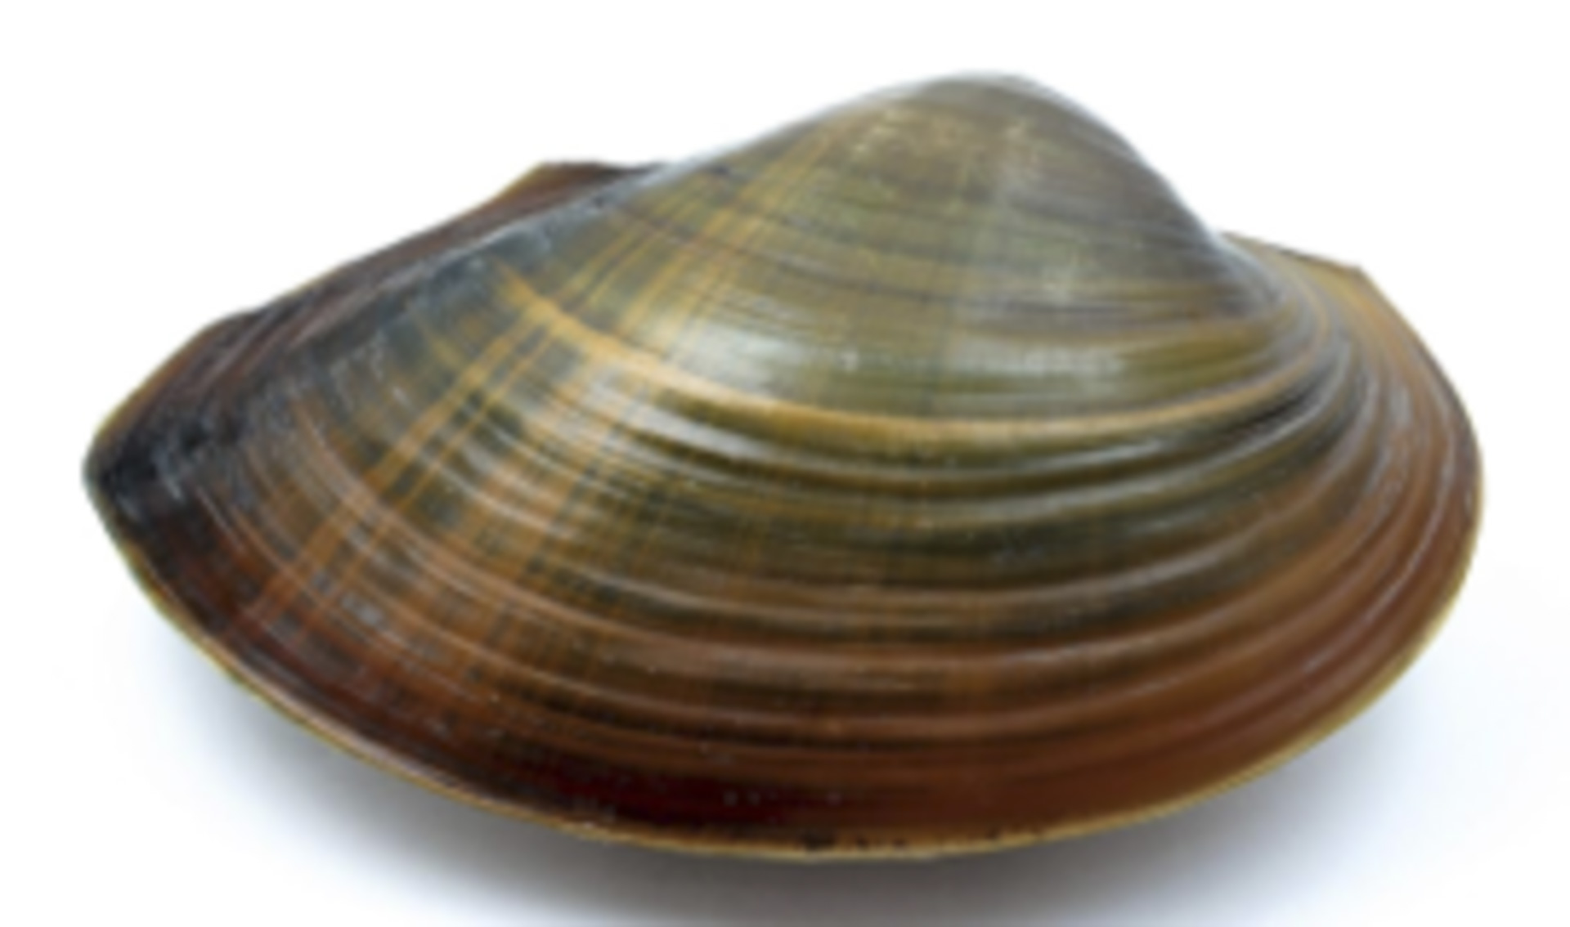
Who lives in and around the stream?
Aquatic animals like:
Trout
Stoneflies
Caddisflies
Crayfish
Freshwater clams
Mayflies

Slide 7
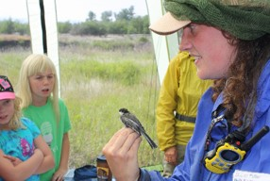
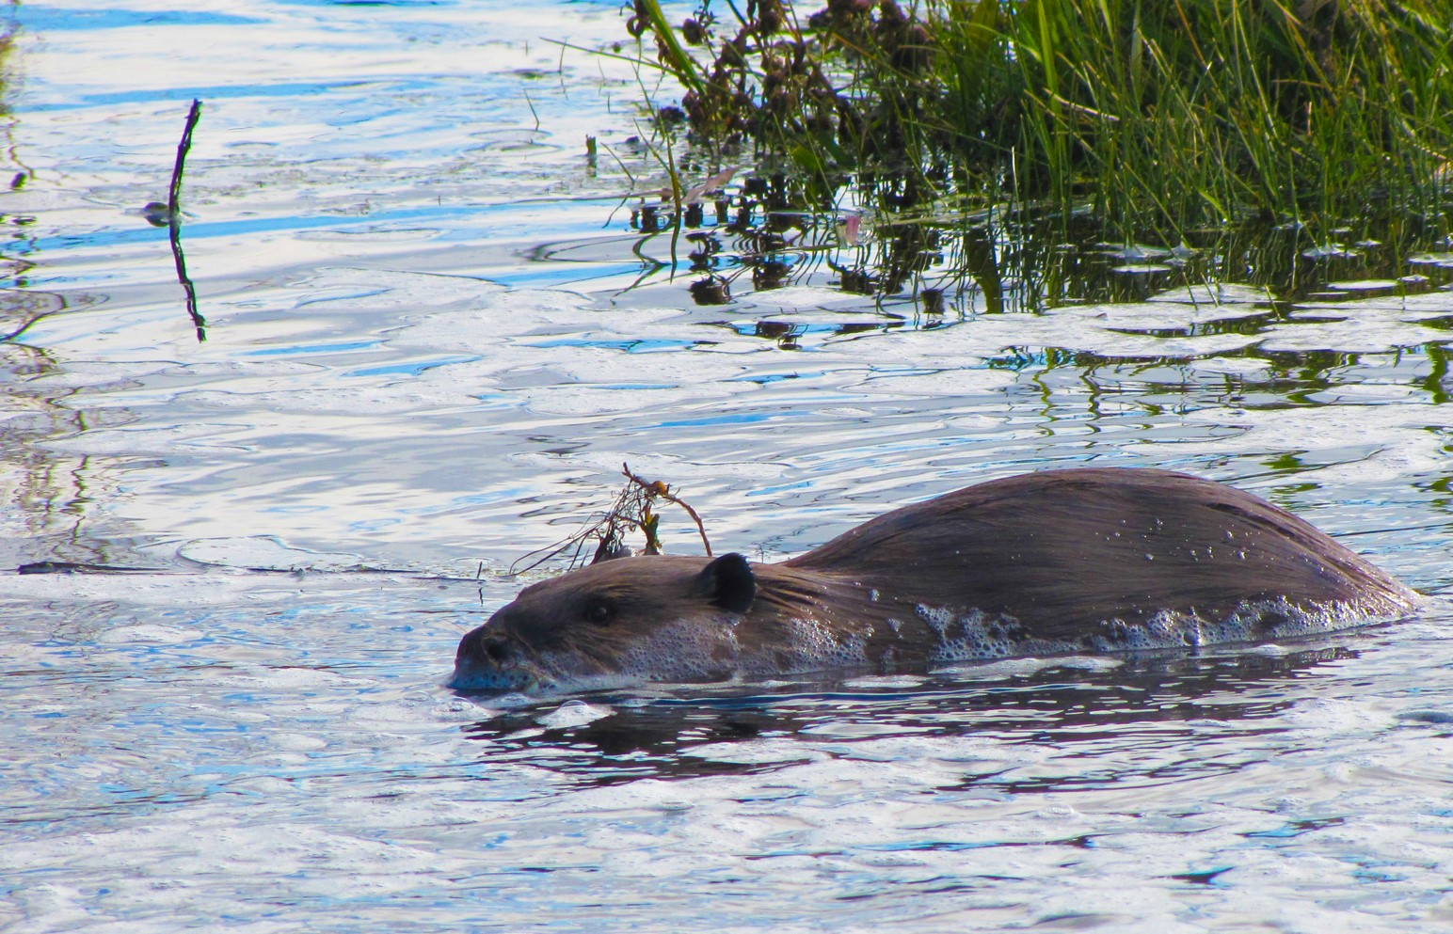
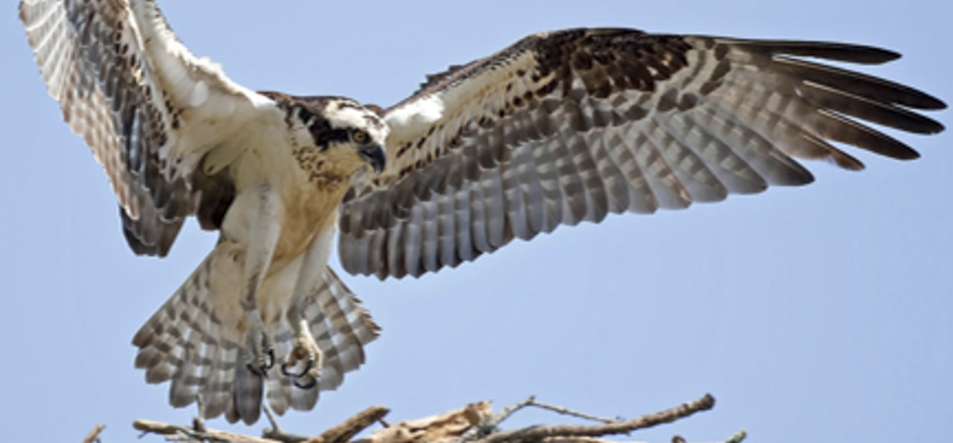
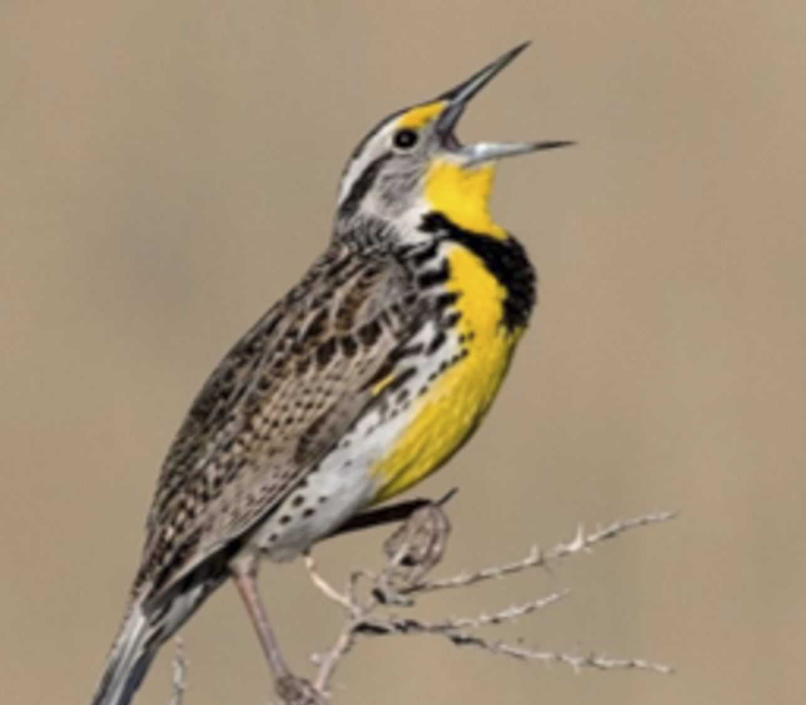
Who lives in and around the stream?
Upland and Semi-Aquatic Animals Like:
Beaver
Osprey
Songbirds

Slide 8

Who lives in and around the stream?
Plants like:
Willow
Cottonwood
Sedges
Rushes

Slide 9
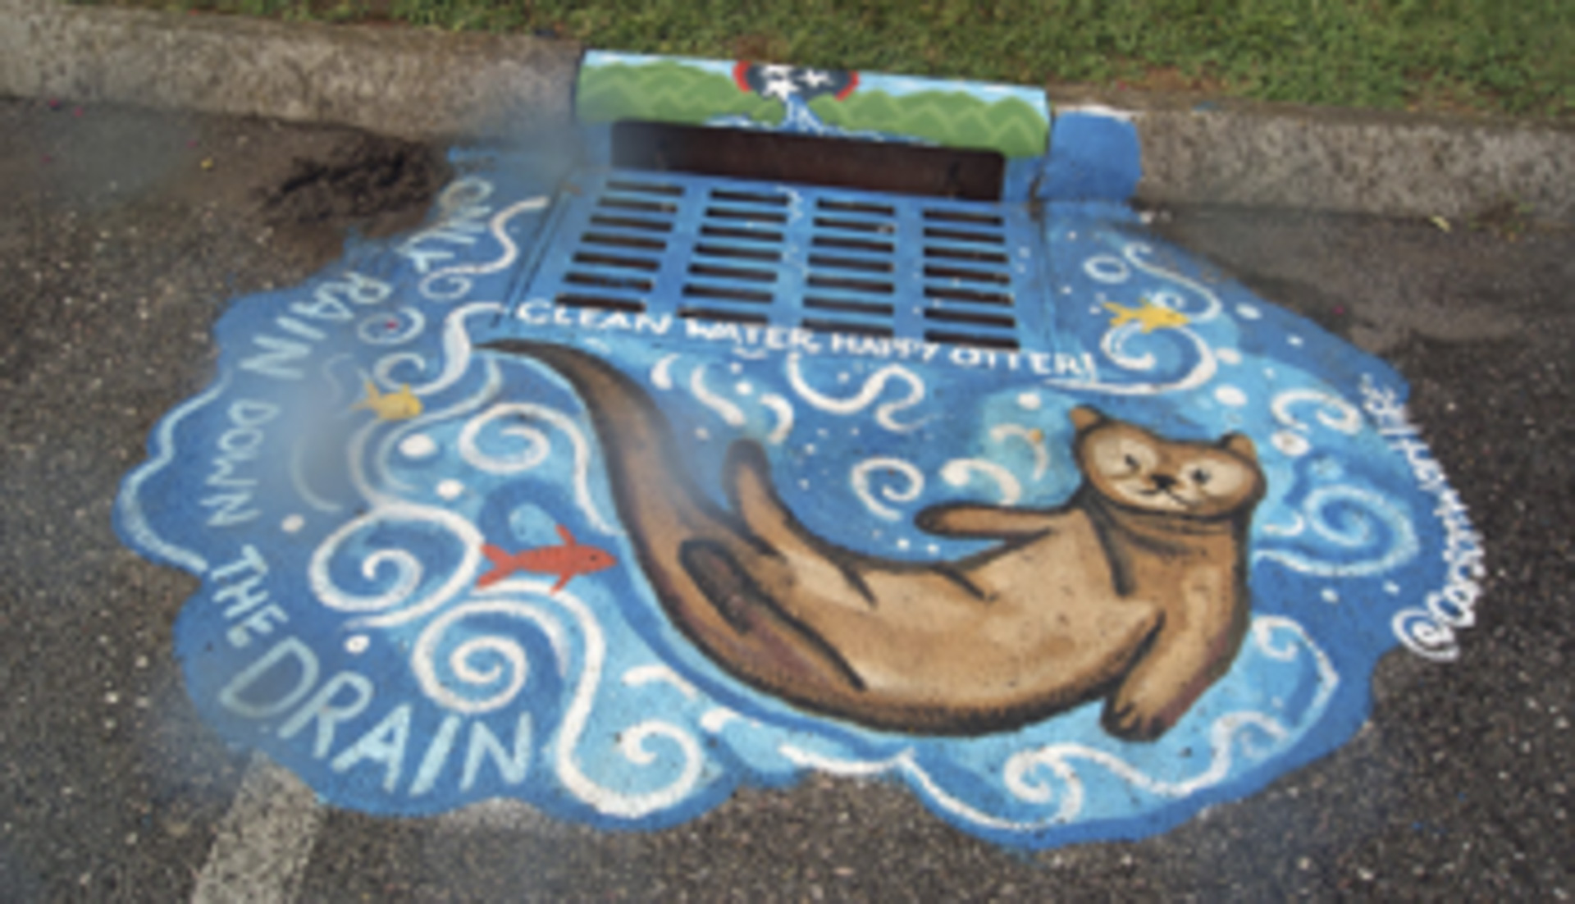
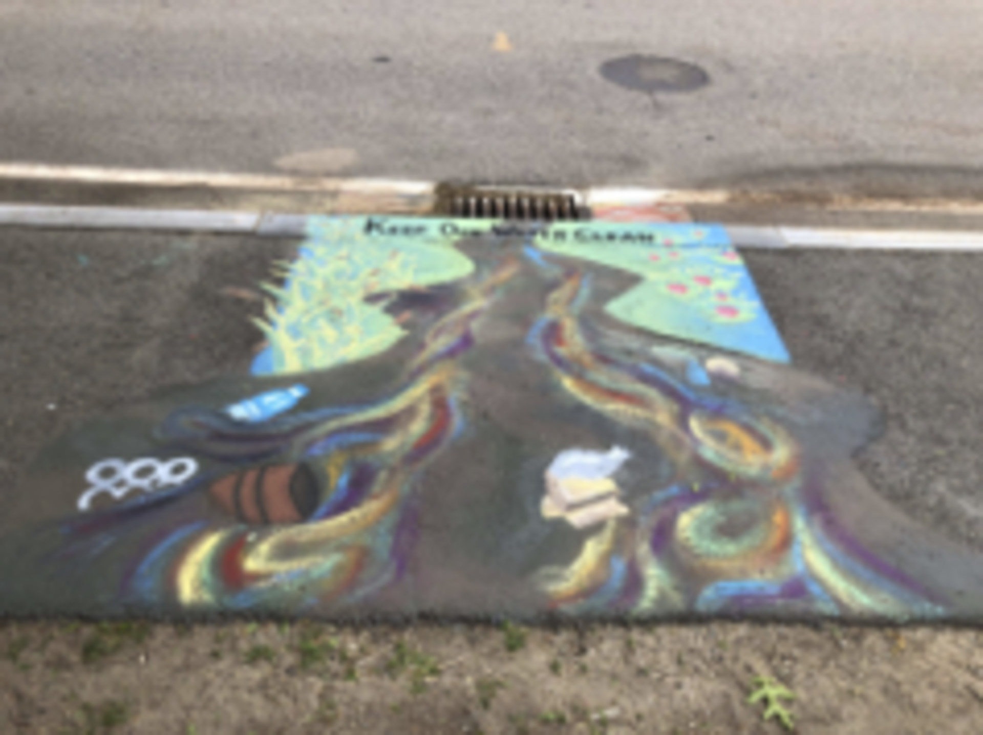
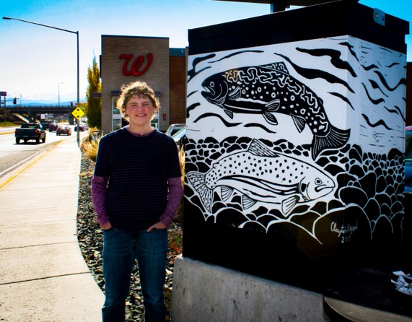
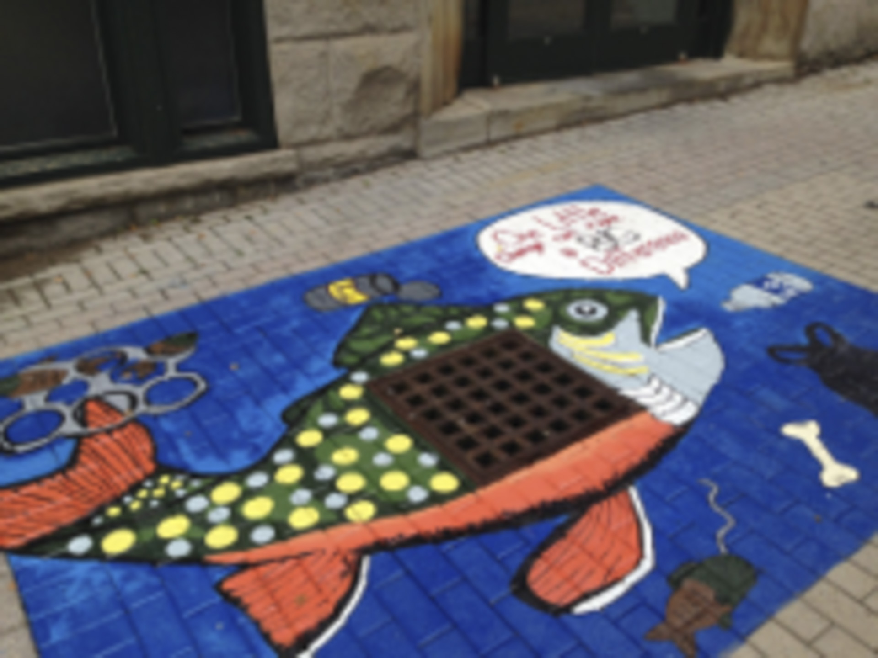
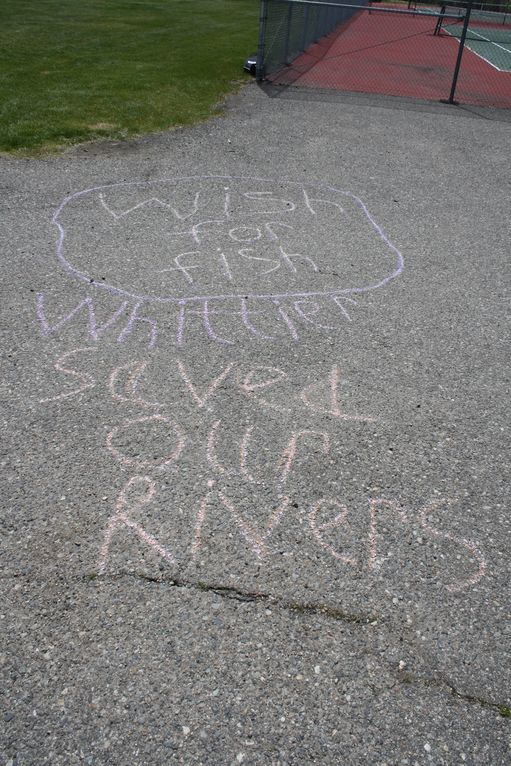
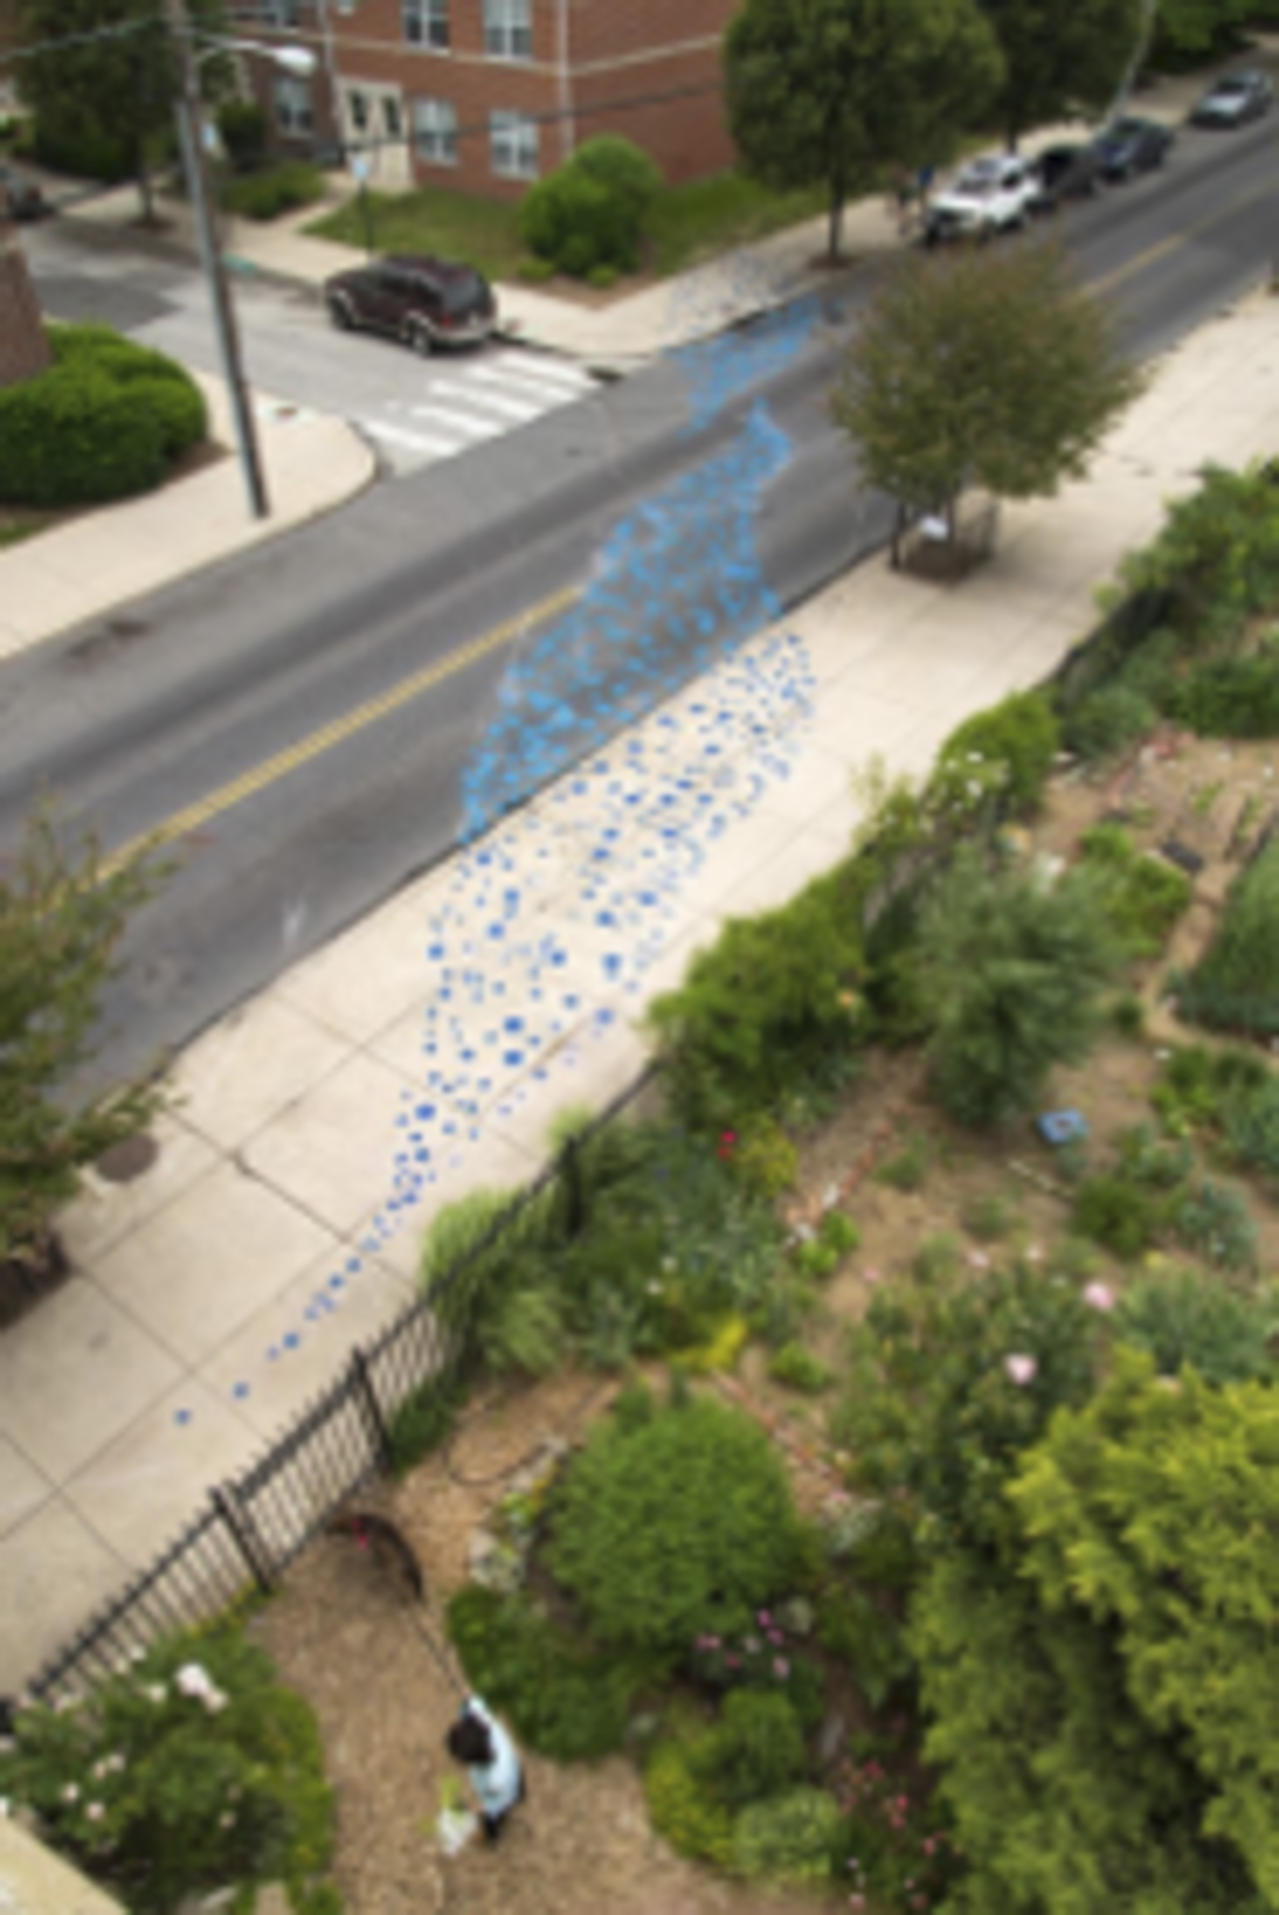
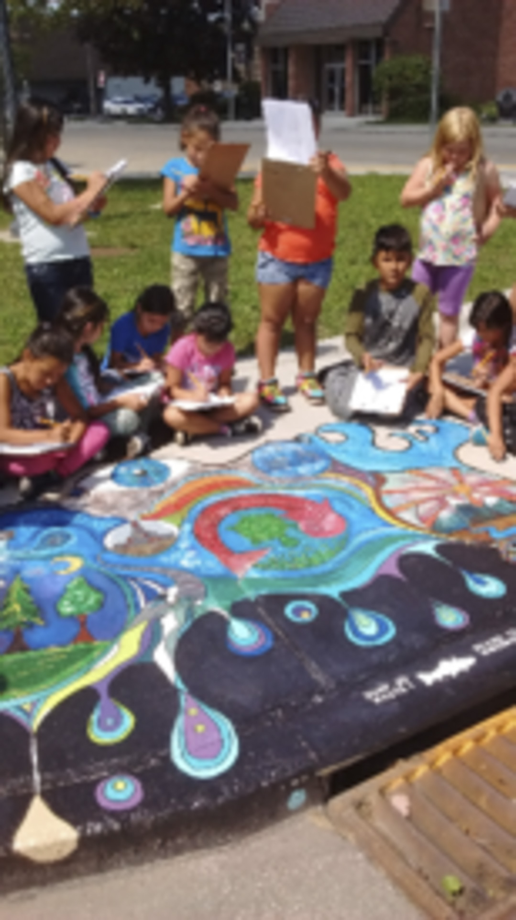
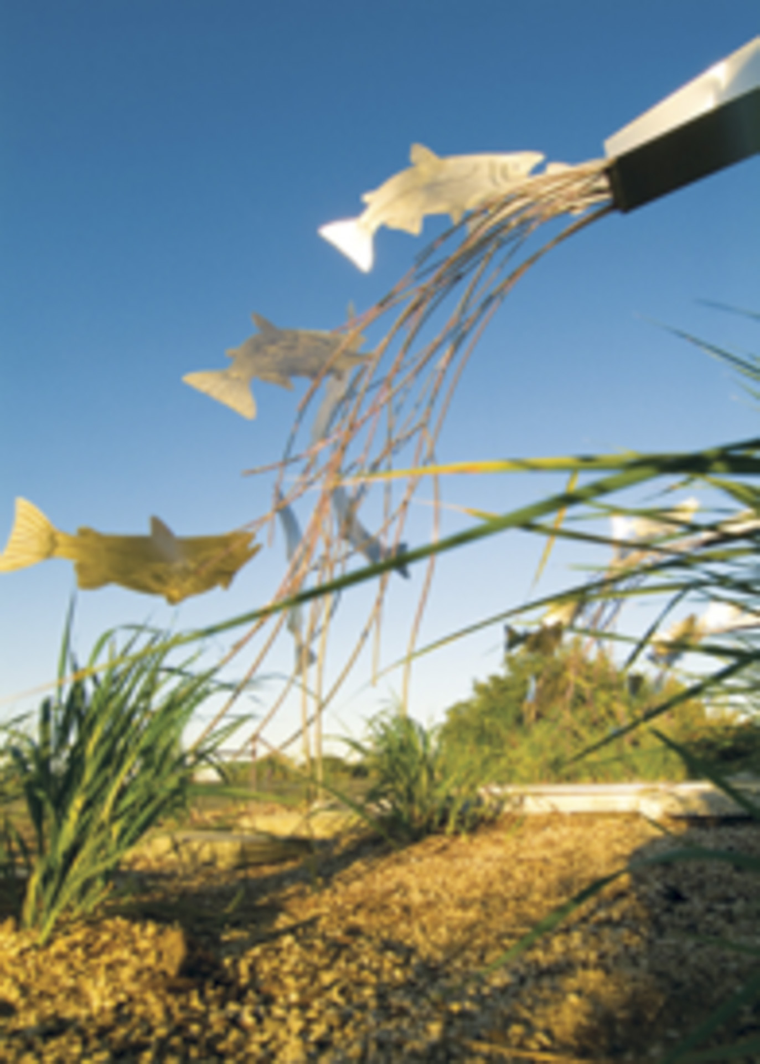
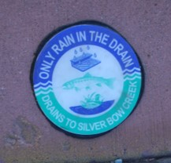
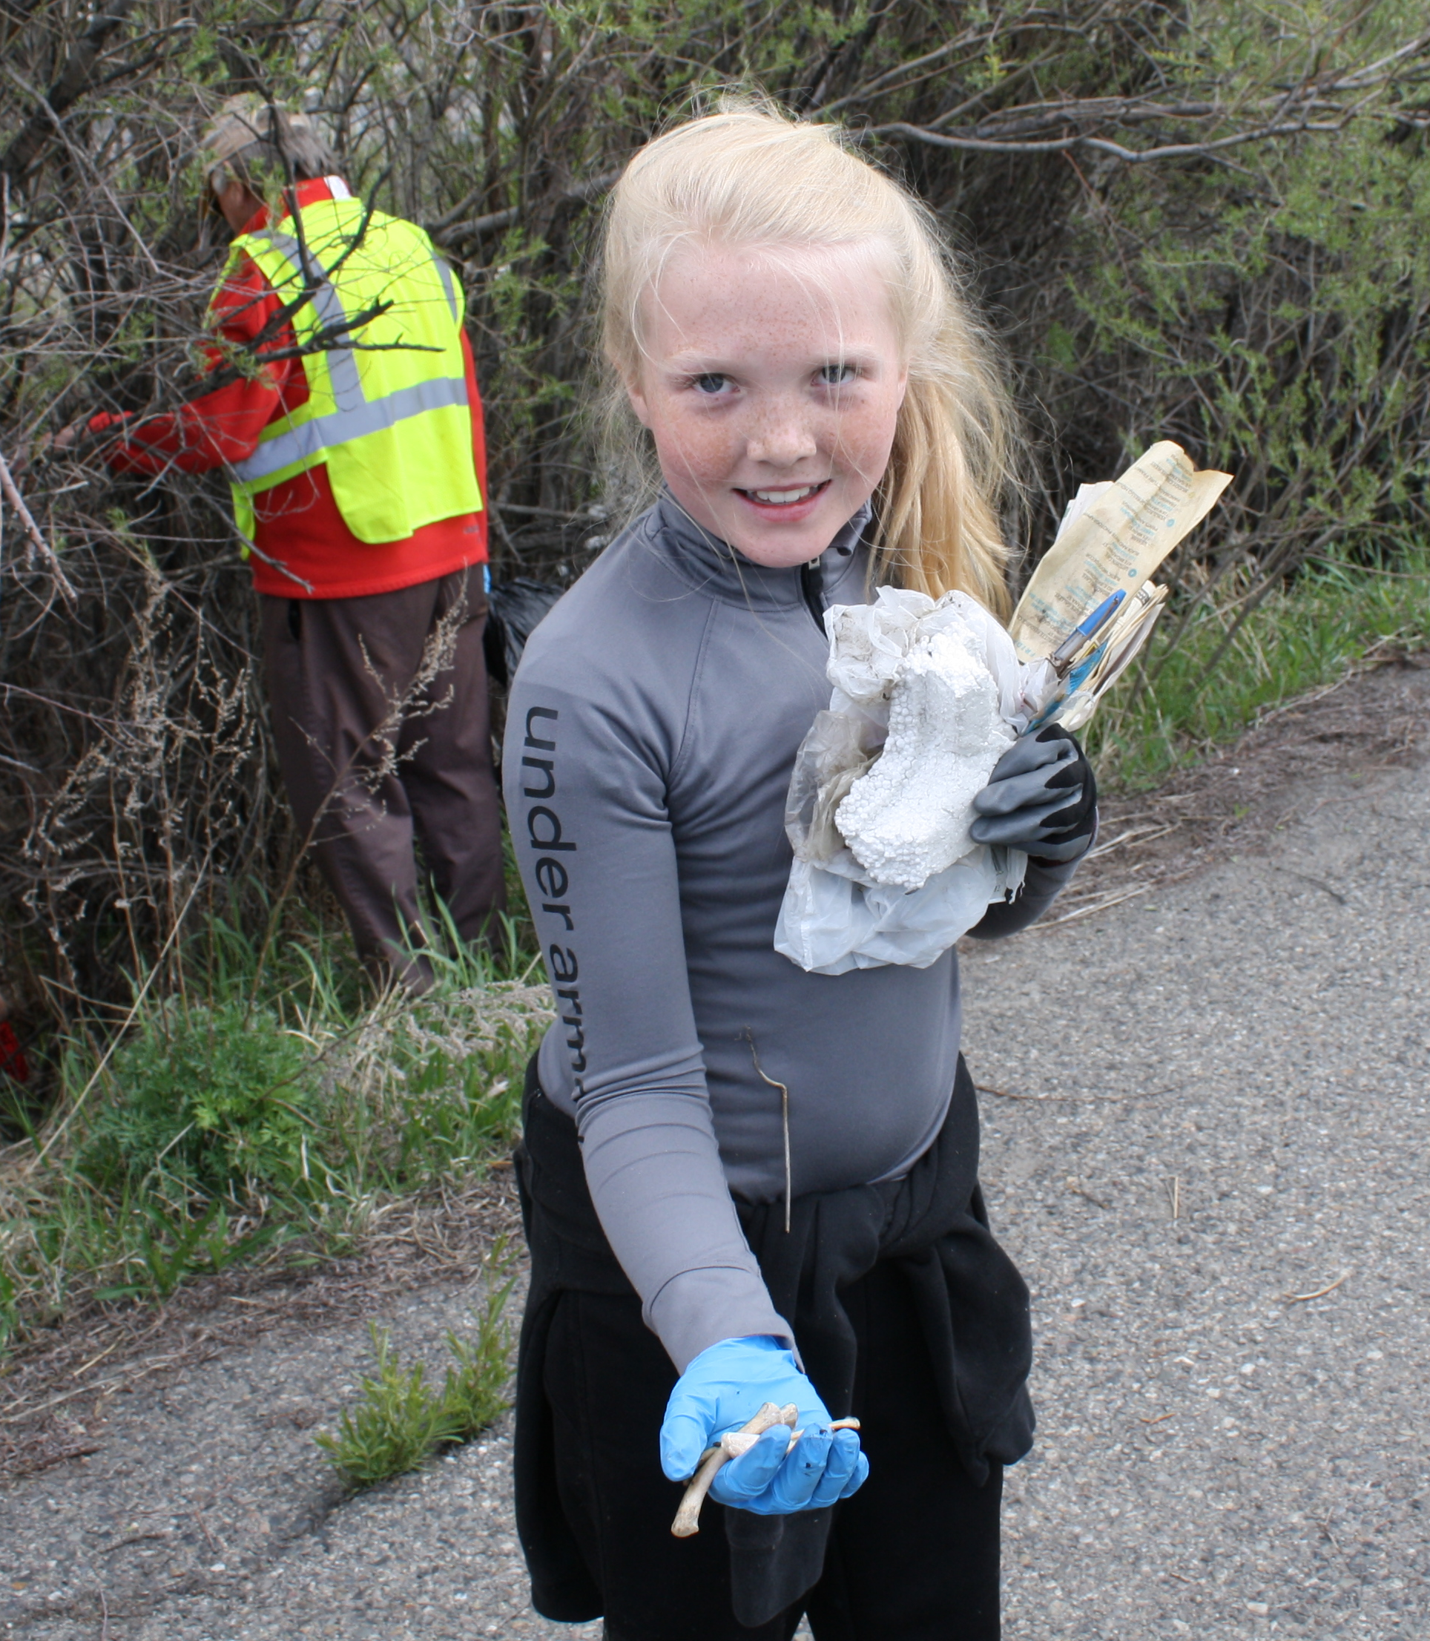
What Are Others Doing?
They are inspiring:
Mindfulness
Change
Empathy
With public art, signs, and PSAs

Slide 10
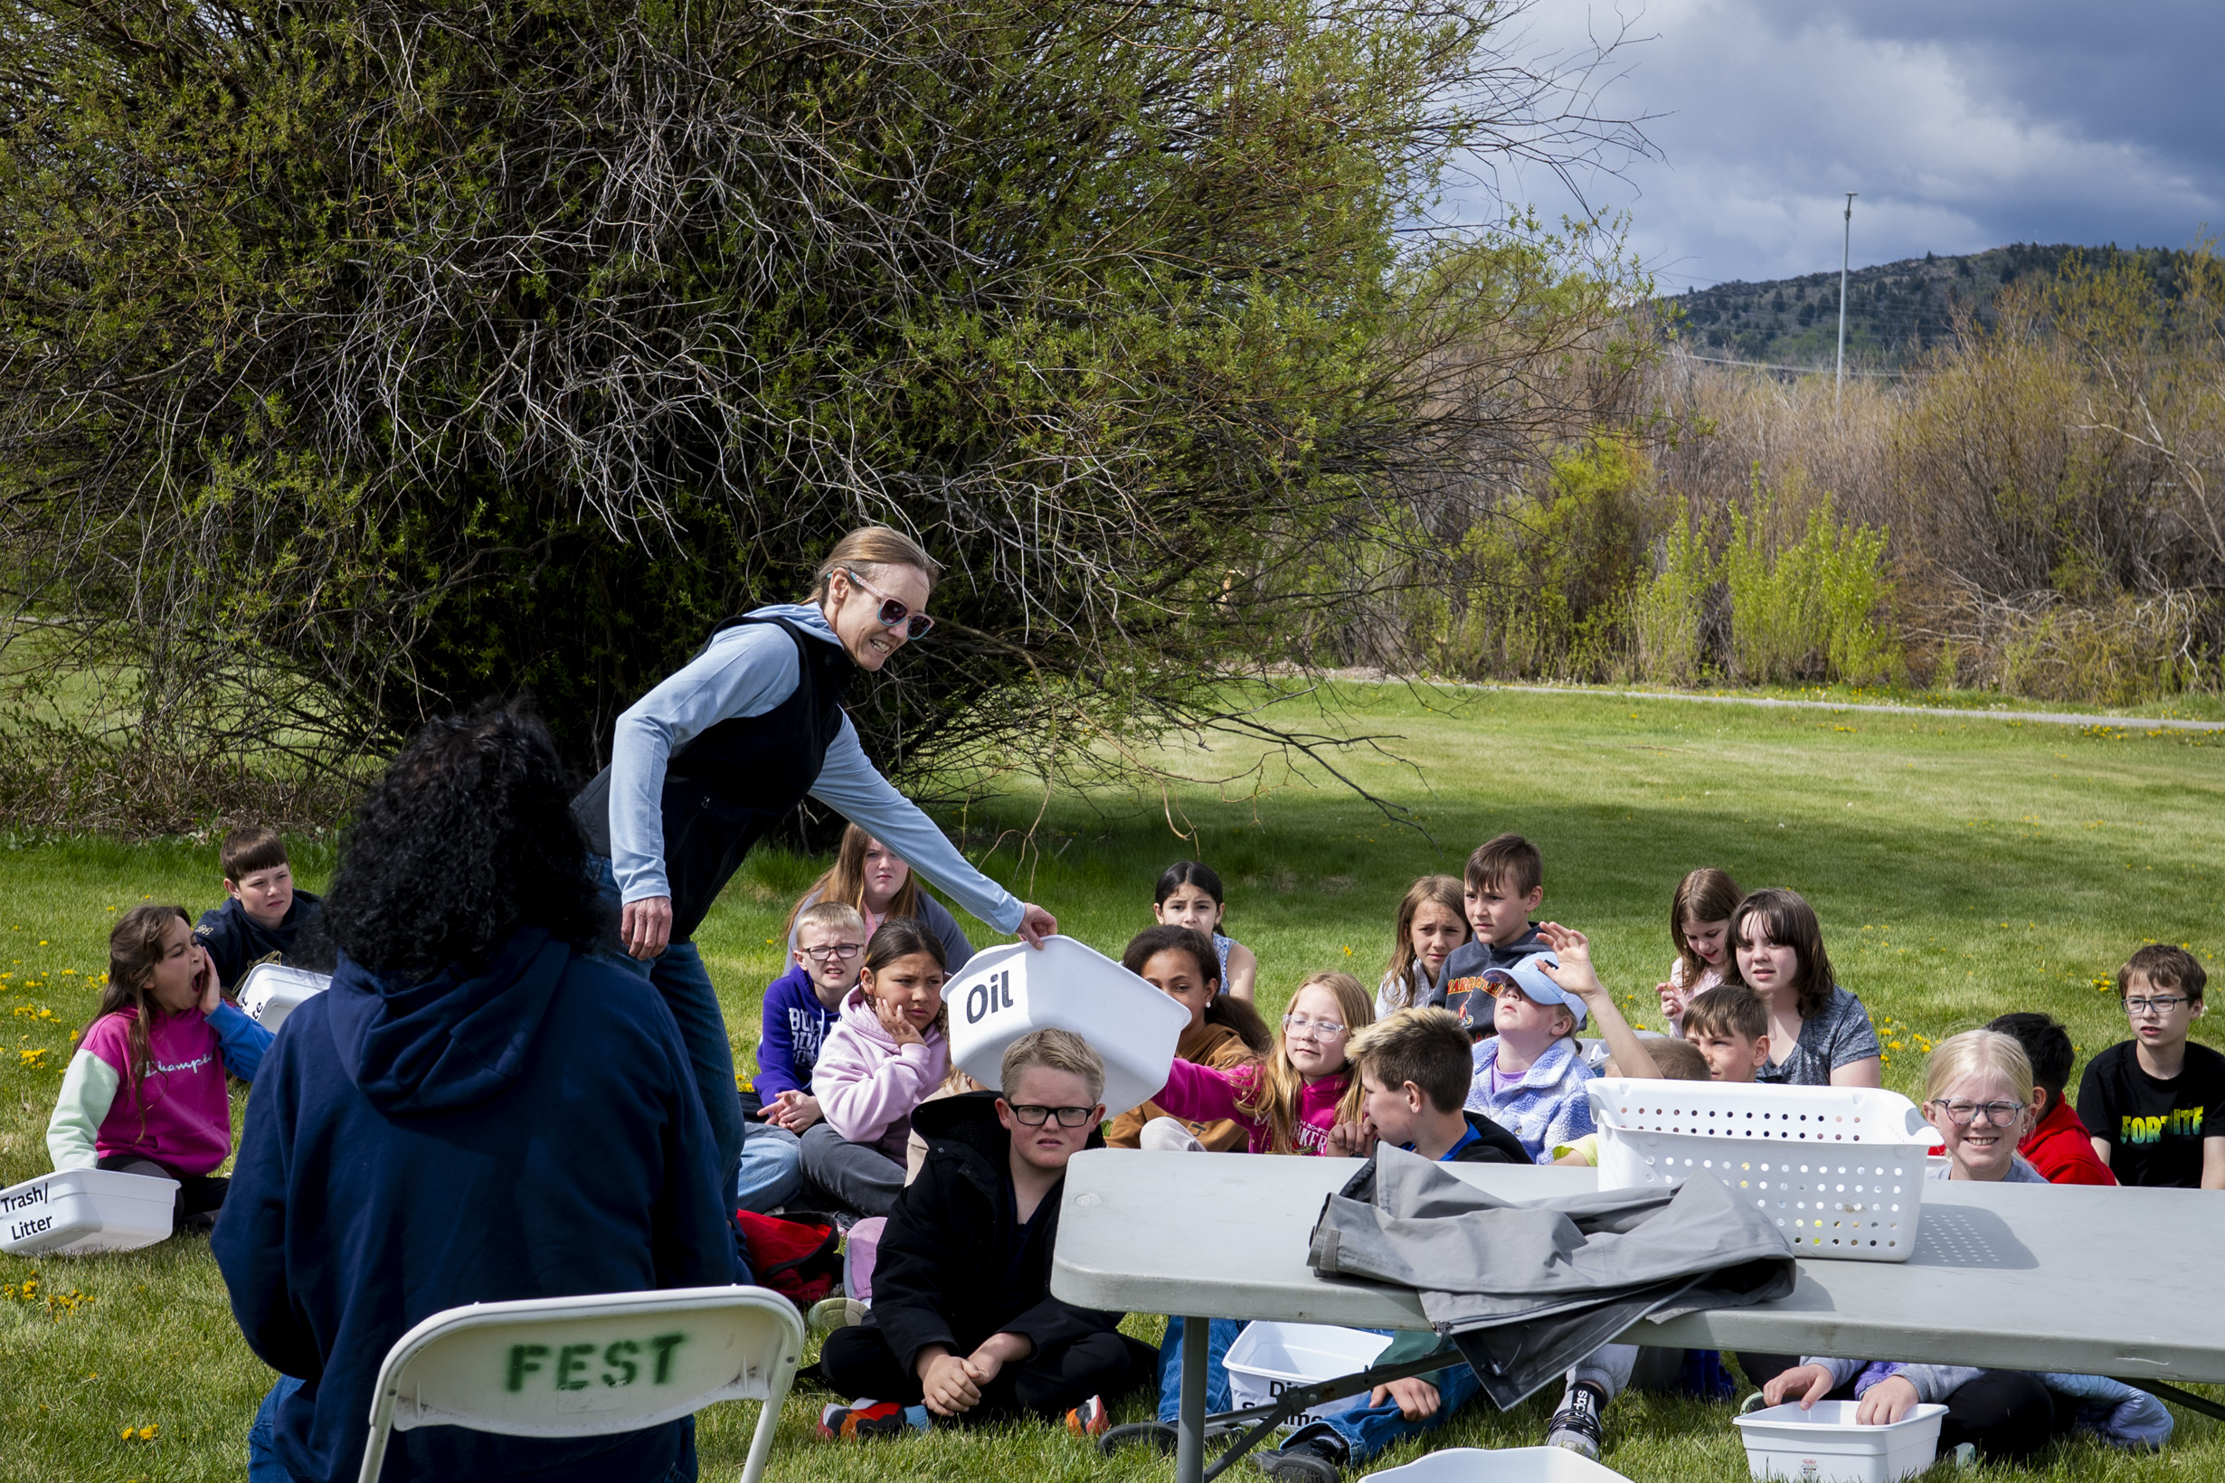
How Can We Encourage Stewardship?
Select Behaviors
Identify Barriers
Develop Strategies
Pilot, Implement, & Evaluate

Slide 11
Planning a Good PSA: Selecting Behaviors
Finding the behavior you want to target is essential to helping you brainstorm effectively. Several important behaviors for stormwater include the following:
All-Season Behaviors | Summer Behaviors | Winter Behaviors
Keep street gutters clean | Use a carwash | Use natural salt or sand
Pick up and dispose of trash properly | Stay on the trail | Shovel snow onto your yard
Scoop the poop! | Dispose of lawn debris in landfills or a compost pile

Slide 12

Planning a Good PSA: Identifying Barriers and Developing Strategies
Complete the following sentences to begin:
It is hard to ____________ because ____________ gets in the way.
I can reduce this barrier by highlighting ____________.
I can increase the barriers to disregarding ____________ by highlighting ____________.
Notes:
Ask them what can we do? Good Housekeeping!

Slide 13
Planning a Good PSA: Pilot, Implement, & Evaluate
Piloting
Write your PSA, and run it by fellow students and community members that might share characteristics with your target audience.
Implementation & Evaluation
Once your PSA has run, send out a survey, ask questions, or talk to the distributer to judge public response. This is not always possible, but trying to understand public response is ideal.

